Slide 1
PGVCL Training
Day-4

Slide 2
Flutter Training for PGVCL Department
Day 4: Internationalization and localization

Slide 3
Overview
Topics We’ll Be Covering For Today
Theory
Concept of internationalization and localization
Flutter’s tool for Localization
Practical
Localize an app with at least two languages using intl package
Assignment
Add support for three languages in the previous day’s app.

Slide 4
Internationalization (i18n) and Localization (l10n) in Flutter
Making Flutter Apps Ready for the Global Stage.
Equip developers with tools and knowledge to build apps for diverse audiences.
Emphasize the importance of adapting apps to different languages, regions, and cultural nuances.

Slide 5
Understanding Internationalization (i18n)
Internationalization (i18n) is the process of designing an application architecture in such a way that it can be easily adapted to various languages and regions without requiring significant changes to the codebase.
Corporate Context:
For PGVCL, this might mean ensuring applications can adapt to Gujarati, Hindi, or other regional languages seamlessly while preserving core functionality.

Slide 6
Understanding Internationalization (i18n)
Key Concepts:
Extract translatable content (e.g., labels, messages) from the source code.
Use placeholders for dynamic content (e.g., user names or numbers).
Account for RTL (right-to-left) languages like Arabic.

Slide 7
Understanding Localization (l10n)
Definition:
Localization (l10n) is the process of translating and adapting an application’s content to meet the language, cultural, and regional requirements of a specific audience.
Key Components:
Text Translation: E.g., "Submit" → "સબમિટ" (Gujarati) or "प्रस्तुत करें" (Hindi).
Locale-Specific Formatting: Dates, numbers, and currencies adapt to local conventions.
UI Adjustments: Ensure proper layout for RTL languages.

Slide 8
Why i18n and l10n Matter
Global Reach: 80% of app users prefer content in their native language. By supporting multiple locales, you increase adoption rates.
Corporate Example: PGVCL apps need to cater to diverse users, including Gujarati-speaking customers.
Improved UX: Users feel more comfortable and confident when using an app tailored to their language and culture.
Regulatory Compliance: Some regions mandate applications to support their official languages.

Slide 9
Why i18n and l10n Matter
Global Reach: 80% of app users prefer content in their native language. By supporting multiple locales, you increase adoption rates.
Corporate Example: PGVCL apps need to cater to diverse users, including Gujarati-speaking customers.
Improved UX: Users feel more comfortable and confident when using an app tailored to their language and culture.
Regulatory Compliance: Some regions mandate applications to support their official languages.

Slide 10
Flutter and Localization
Why Flutter?
Built-in support for internationalization through the intl package.
Easy integration of ARB (Application Resource Bundle) files for managing translations.
Flutter widgets adapt naturally to locale changes (e.g., TextDirection.rtl for RTL languages).
Modern and efficient workflow for scaling to multiple languages.

Slide 11
Flutter's Tools for Localization
Key Tools:
intl Package: Manages date, time, and number formatting, as well as message translations.
ARB Files: Centralized storage for translations in a JSON-like format.
Localizations and LocalizationsDelegate:
Automate and simplify locale switching.
Enable runtime localization changes.
Unique Feature: Flutter also provides out-of-the-box widgets for localization, like MaterialLocalizations.

Slide 12
Workflow for Localization in Flutter
Step-by-Step Guide:
Install the intl package: yaml Copy code dependencies:
flutter:
sdk: flutter
intl: ^0.18.0
Create ARB Files:
Example: app_en.arb for English, app_gu.arb for Gujarati.

Slide 13
Example: Localized Flutter App
Context: Suppose PGVCL wants to support English and Gujarati.
Implementation:
Create ARB files:
app_en.arb: { "greeting": "Welcome to PGVCL" }
app_gu.arb: { "greeting": "પીએજવીસીએલમાં તમારું સ્વાગત છે" }
Implement localization: dart Copy code Text(Intl.message('Welcome to PGVCL')),
App adapts dynamically based on the selected locale.

Slide 14
Challenges in Localization
Challenges:
Managing complex translations (e.g., pluralization).
Keeping translations consistent across locales.
Adapting UI for RTL languages and text overflow.
Solutions:
Use tools like Localise for managing translations.
Test thoroughly in all supported languages and locales.
Plan for flexible UI layouts.

Slide 15
Conclusion
Key Takeaways:
Internationalization (i18n) lays the foundation for global-ready apps.
Localization (l10n) ensures apps cater to specific audiences effectively.
Flutter provides a rich ecosystem to simplify i18n and l10n processes.
Call to Action:
Start integrating i18n into your current projects.
Use Flutter’s tools to streamline the localization process.

Slide 16
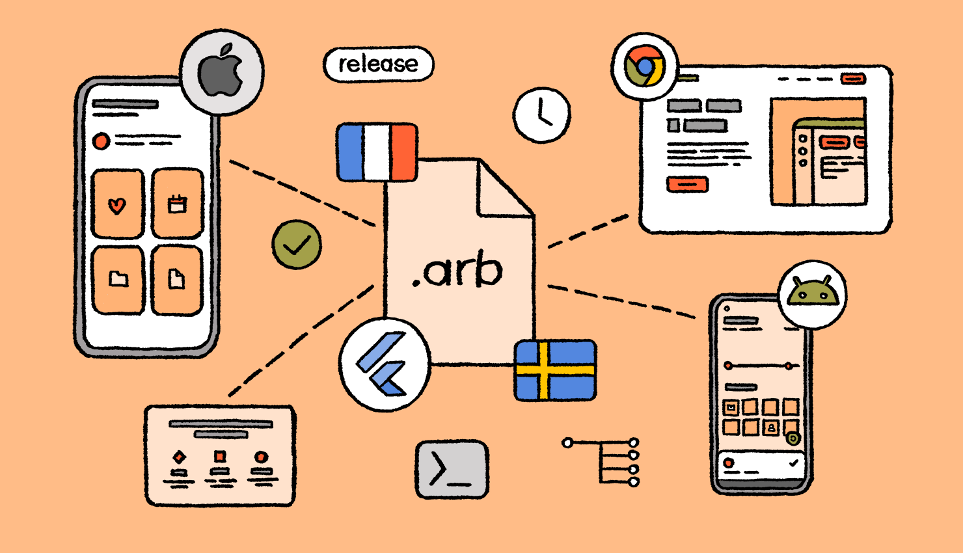

Slide 17
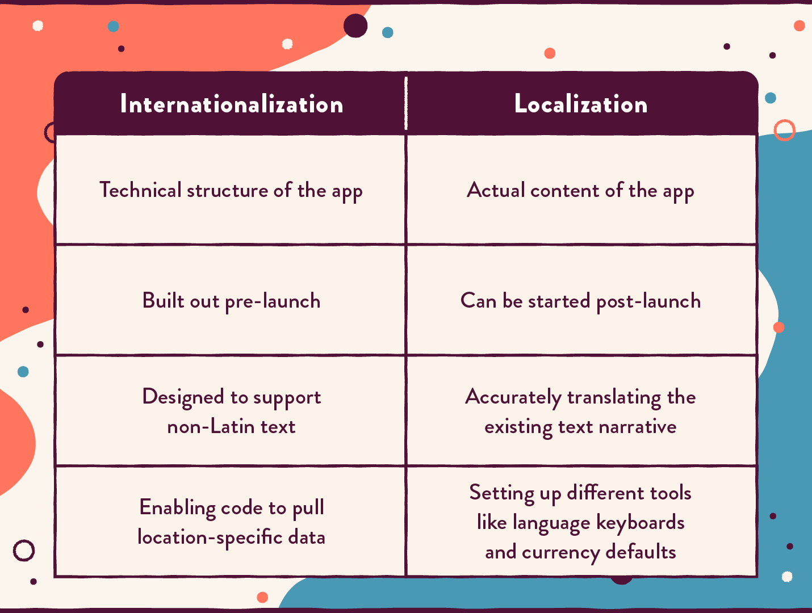

Slide 18
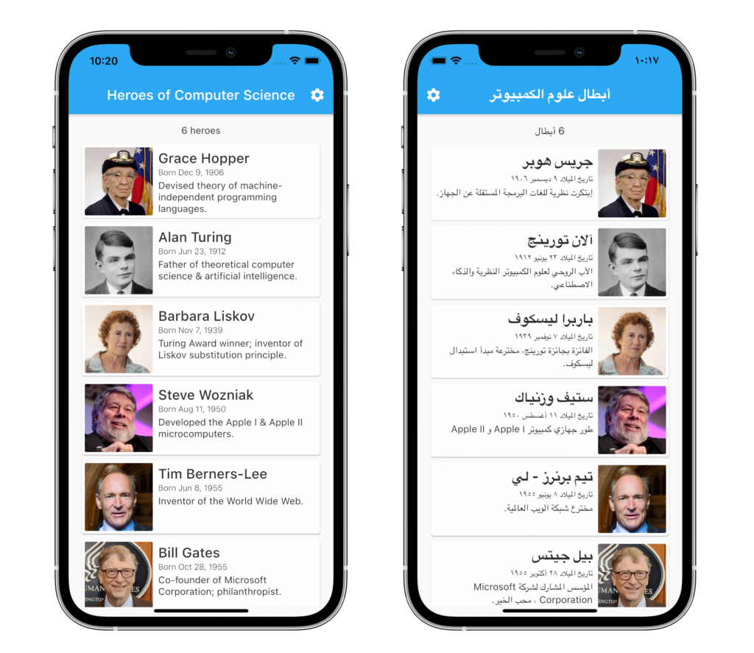

Slide 19
Practical Example
Link
Assignment Example
Create a basic UI with 3 Stateless Widgets and 2 Stateful Widgets

